Slide 1
Using data to predict abalone age
By Orie Wyatt

Slide 2
Abalone, similar to trees, grow a new ring each year allowing us to date them (age = rings + 1.5 yr). This task is labor intensive. Can we use machine learning algorithms to help us predict the age of each abalone?

Slide 3
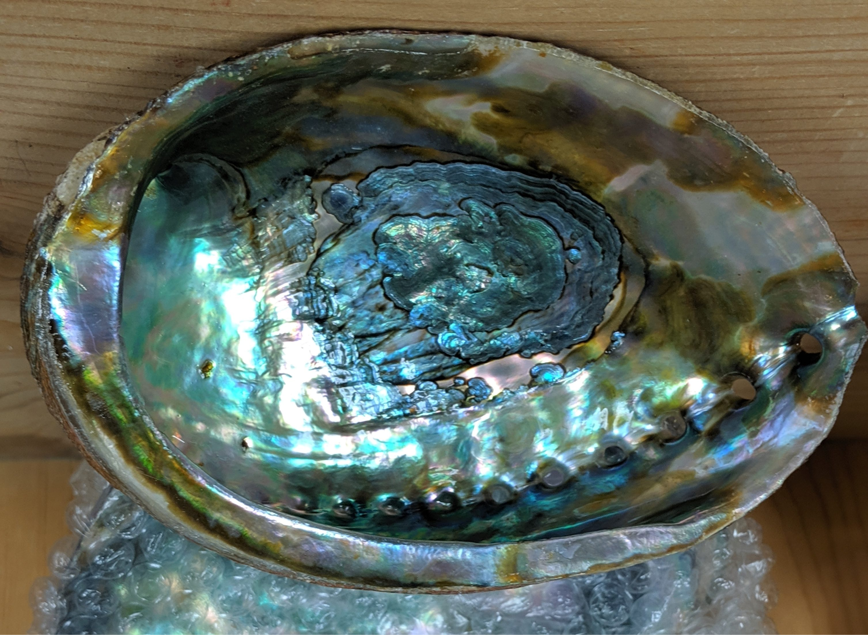
EDA

Slide 4
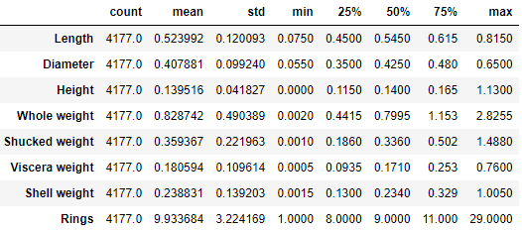
Data Metrics
Rings (age) range from 1-29
Weight columns tend to vary more than the dimensional metrics.
The dataset has nearly 4200 samples.
Sex was removed for simplicity.

Slide 5
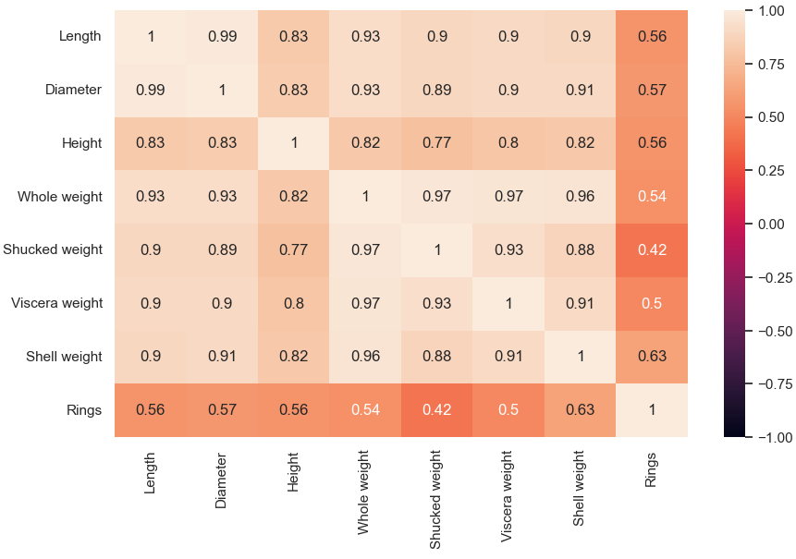
Correlation Heatmap
Many variables are similar in nature and are all highly correlated with each other.
The dependent variable in this case is the odd factor out with correlation coefficients ranging from 0.42 to 0.63
Oddly enough, these are both weight metrics.

Slide 6
Models

Slide 7
Model 1. Linear Regression

Slide 8
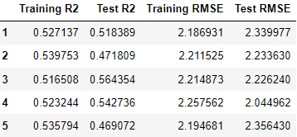
Linear Regression: R2 and RMSE
Average Training R2: 0.528
Average Test R2: 0.513
Average Training RMSE: 2.213
Average Test RMSE: 2.240

Slide 9
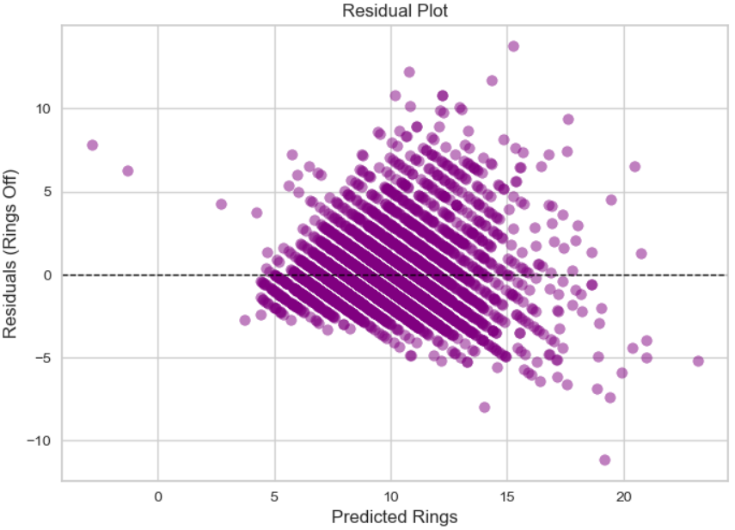
Linear Regression: Residual Plot
Dashed line: prediction
Distance from dashed line is the error in estimation
Negative values need tweaked to account for negative age predictions

Slide 10
Model 2. Lasso Regression

Slide 11
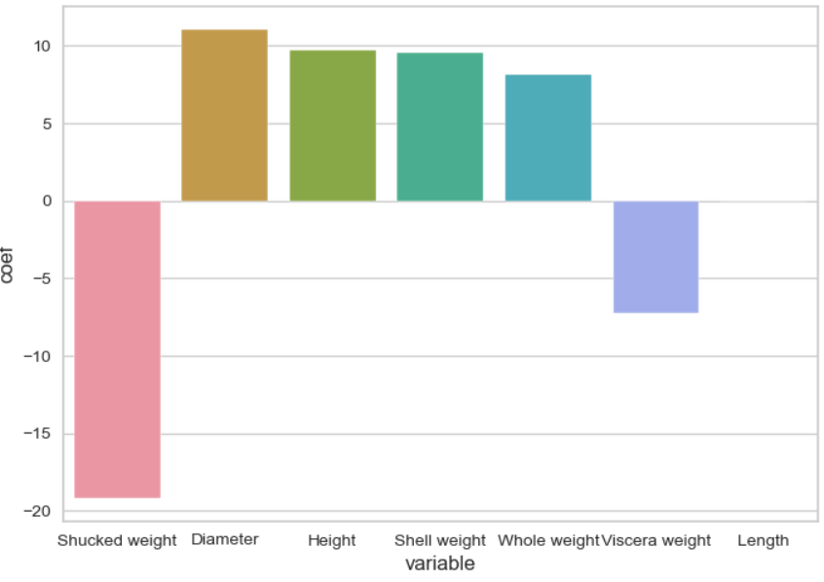
Coefficient Regularization
Shucked weight appears to be the most important coefficient.
Length is reduced to zero in Lasso Regression

Slide 12
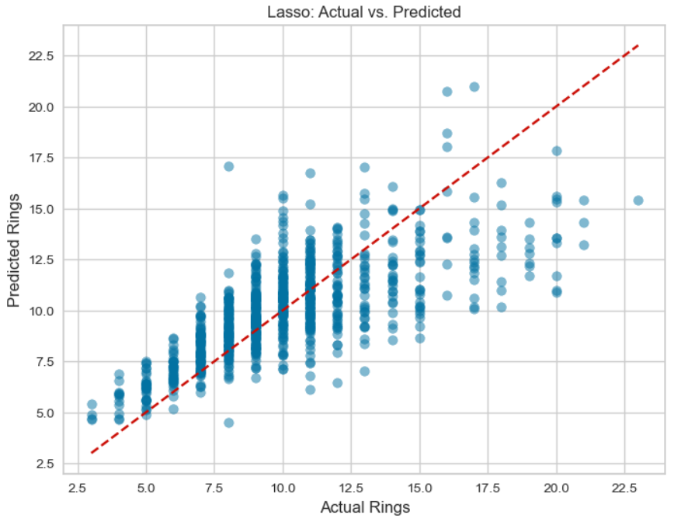
Visualizing Lasso Regression Model
As in the linear regression, the residual increases as the abalone gets older, making it harder to predict.
Training R²: 0.522
Test R²: 0.543
Training RMSE: 2.226
Test RMSE: 2.186

Slide 13
Model 3. Random Forest Regression

Slide 14
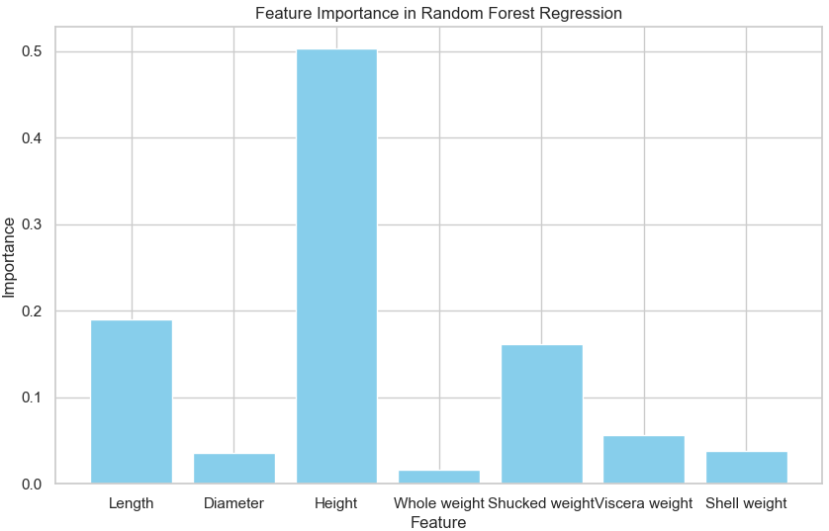
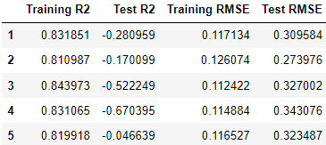
Random Forest Regression
OOB Score: 0.297
Low
Mean Square Error: 0.950
R-squared: 0.909
________________________________
Cross-validation and low OOB Score indicates highly overfitted model.

Slide 15
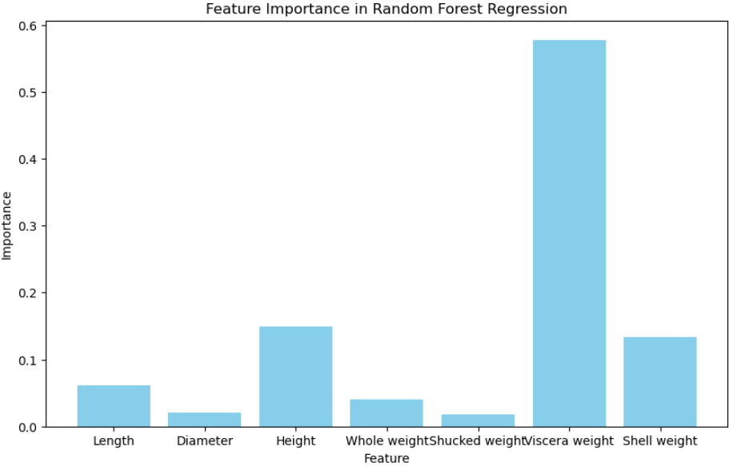
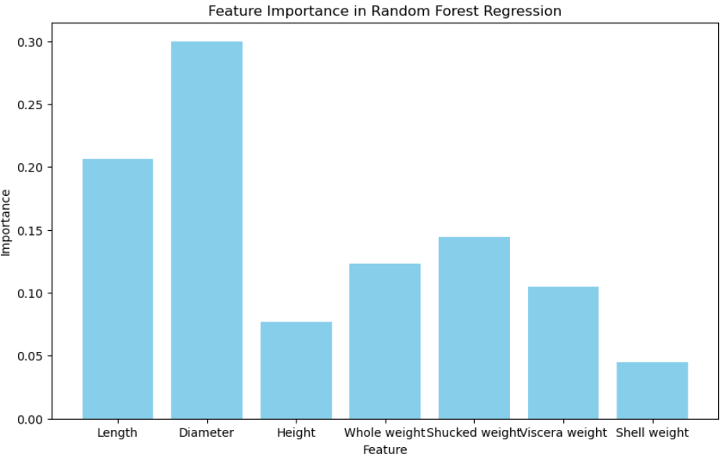
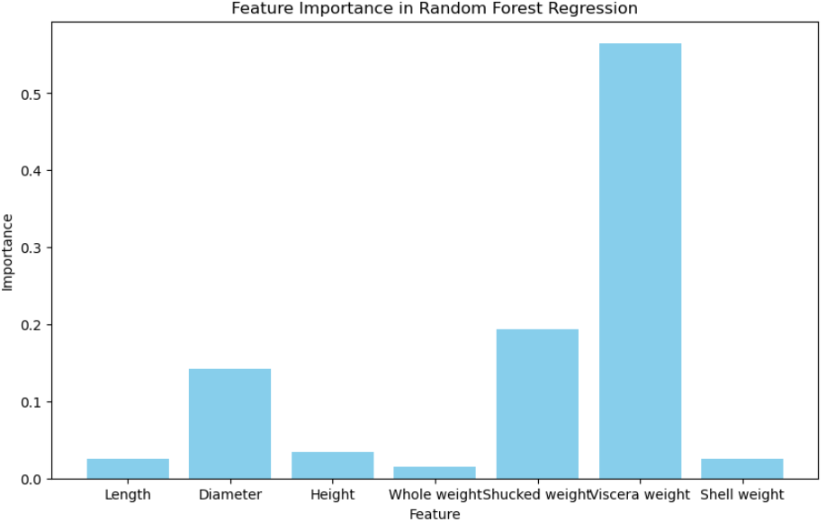
Random Forest Regression Iterations

Slide 16
Conclusions

Slide 17
Conclusions
Linear Regression and Lasso Regression performed similarly well
Training R2: 0.528
Test R2: 0.513
Training RMSE: 2.213
Test RMSE: 2.240
Random Forest Regression seemed to overfit with high OOB score
Different models seem to emphasize different variables.
Training R²: 0.522
Test R²: 0.543
Training RMSE: 2.226
Test RMSE: 2.186

Slide 18
Future Work
Compare approach to others’ attempts
Common dataset
Attempt to bin ages or set up threshold:
E.g. Which abalones are older than 7 years old?
E.g. Bin abalone in sets of 5 years (0-5, 5-10, 10-15, etc.)
Ensemble method approach
Data Source: https://archive.ics.uci.edu/dataset/1/abalone

